Slide 1

CMPE - 287 Software Quality Assurance
Project – Testing Instagram mobile application
Session-1; Group -6
Divanshu Arneja
Piyush Seth
Saumil Jain
Shilpa
Surbhi Rautji

Slide 2
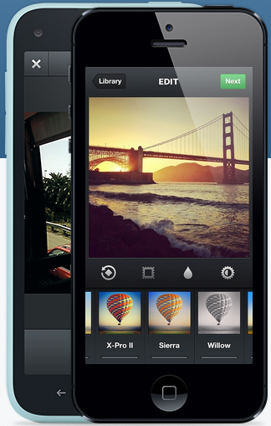
Introduction
Photo/Video sharing mobile application.
Like/Comment/Follow/Unfollow.
Photo/Video can be shared on various popular social networks.
Very popular among youth, having more than 200 million users.
Has its own social ecosystem.
Location based tagging of photo/video.
User can view each other’s photo/video mapped on the map.

Slide 3
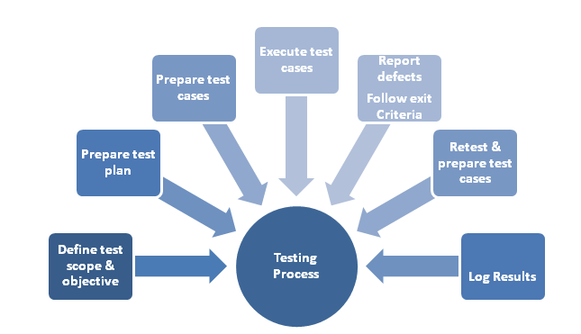
Test Plan
Testing Application
Testing Devices
Role and Responsibility
Schedule and Templates

Slide 4
Testing Coverage
Target coverage criteria:
Home Screen
Explore Screen
Camera
Photomap –Geotagging
Following/News
User Profile
Gestures
GUI
Location Based
Environment and Platforms
Non Functional Requirements

Slide 5
Testing Tools
Element Tool
Bugzilla
Automation - Perfecto Mobile
Performance - NeoLoad

Slide 6
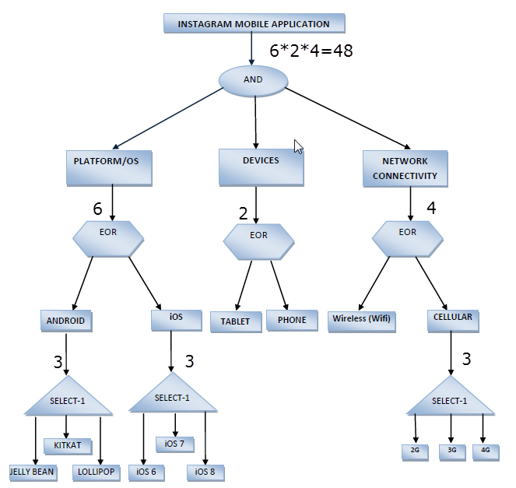
Test Design: Testing Model
Semantic Tree Model
Complexity for Application Functionality- 3960
Complexity for Application Environment- 48

Slide 7
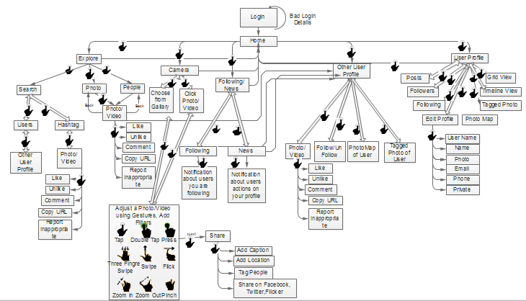
GUI flow Model
Gestures tested – 12
Complexity for GUI Model- 127

Slide 8
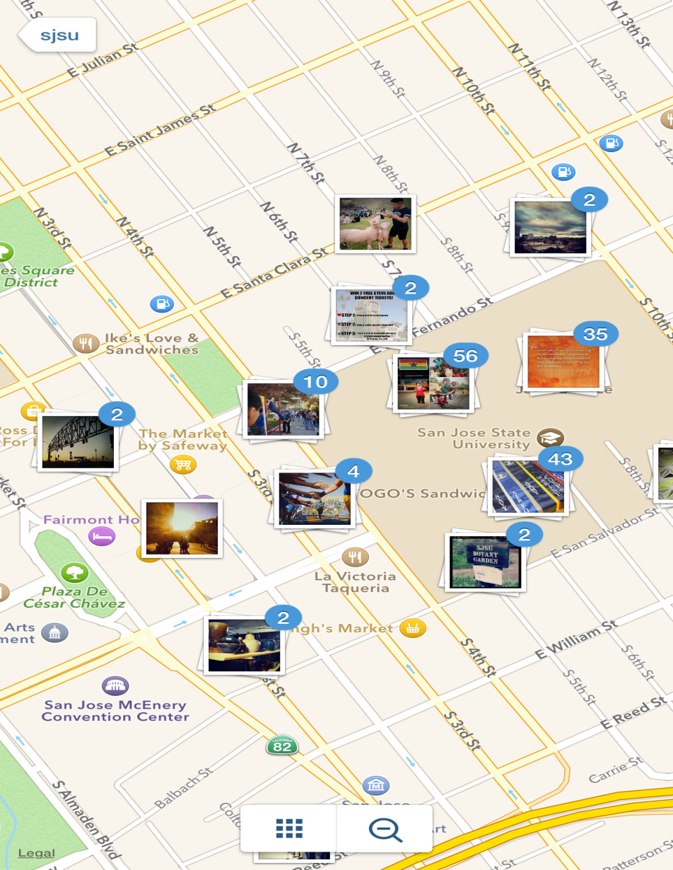
Location Based Model
Geo Objects -10
Mobile Objects Type-2
Pictures
Videos
Total Objects of Different
Type -12
Passive Mobile Objects -160
Active Mobile Objects- 0
Service of each object
Geo objects – 0
Mobile objects – Active – 0
Mobile objects – Passive – 12
Complexity –
Gi = {Map, Ni, Si, Ri} = {1,12,11,1}

Slide 10
Test Design
Testing Methods
Decision Based Testing Method
Equivalence partition testing Method

Slide 11
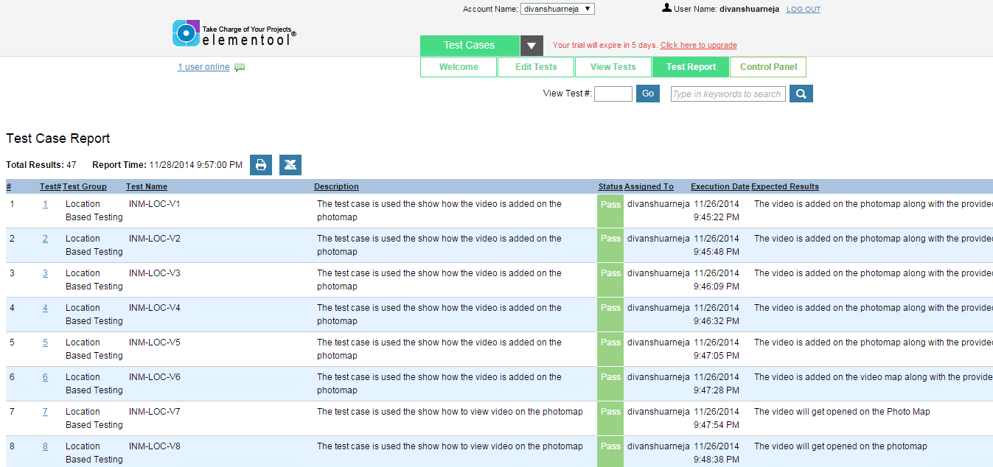
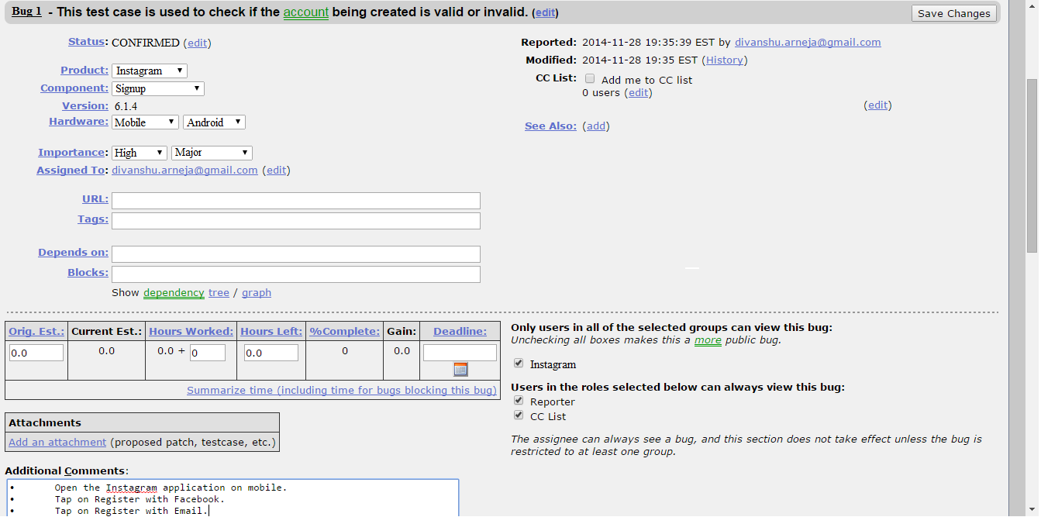
Manual testing
Tools used –
Elementool (Test case reporting and Issue tracking)
Bugzilla

Slide 12
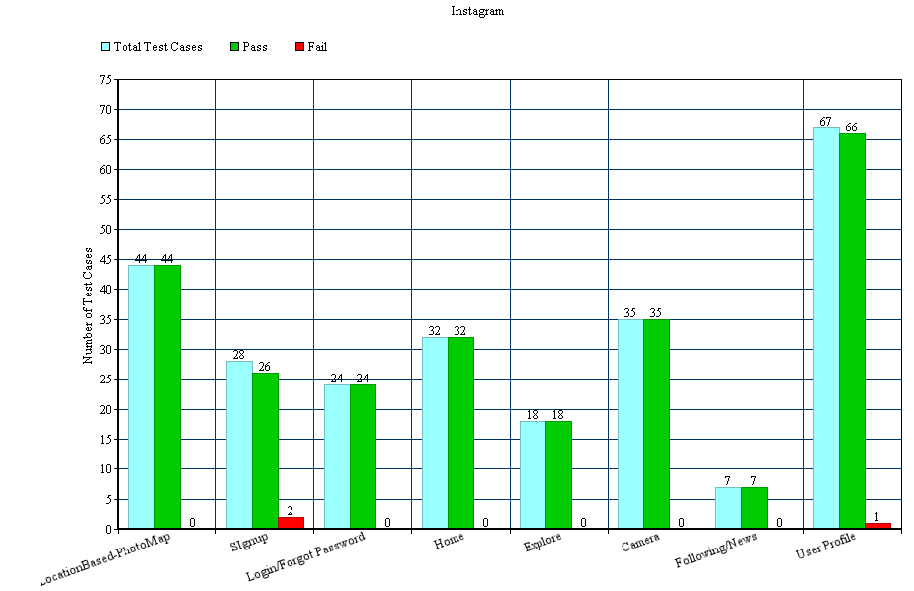
Manual testing
Testing statistics of Application–

Slide 13
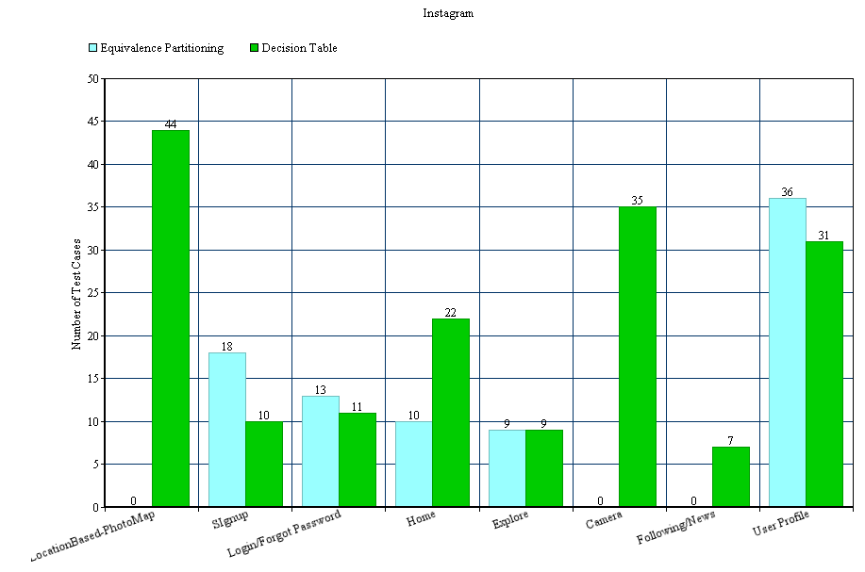
Manual testing
Testing statistics of testing methods used–

Slide 14
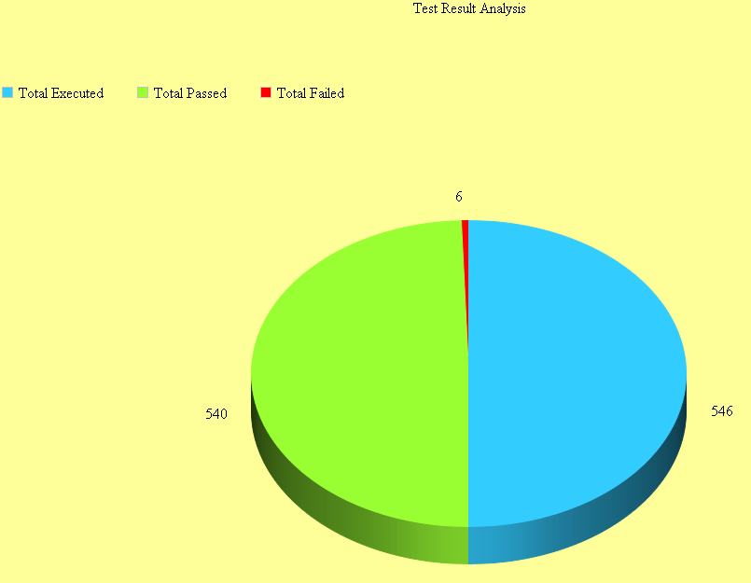
Manual testing
Testing statistics–

Slide 15
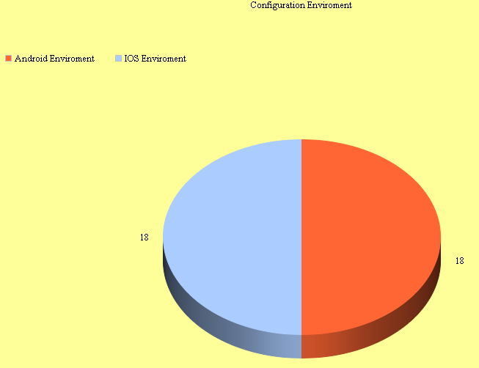
Manual testing
Configuration Testing statistics -

Slide 16
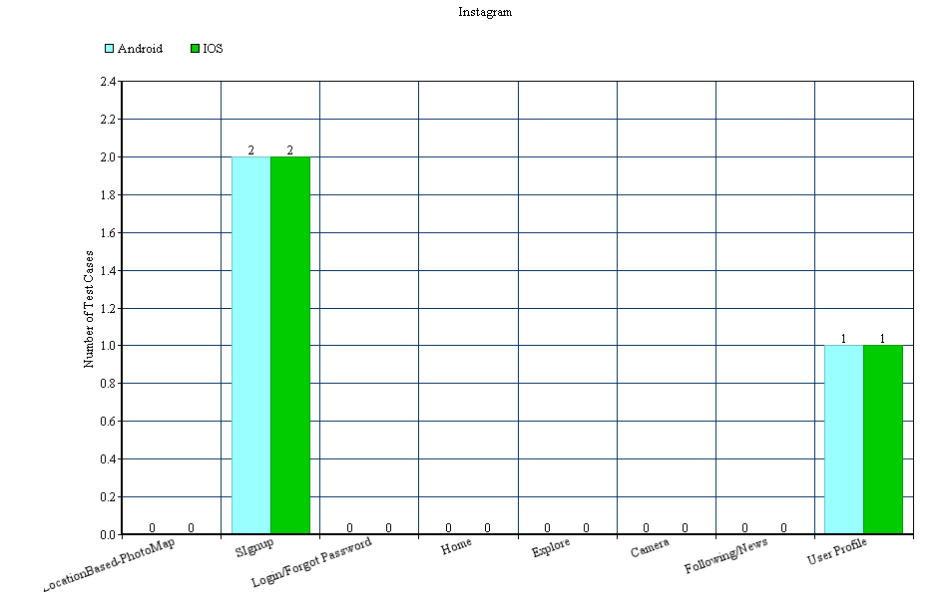
Manual testing
Bugs with respect to environments-

Slide 17
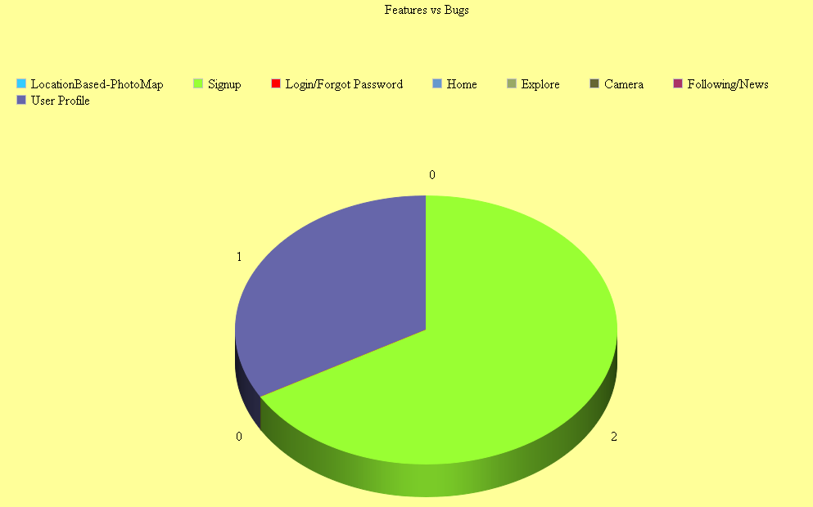
Manual testing
Feature vs Bugs-

Slide 18
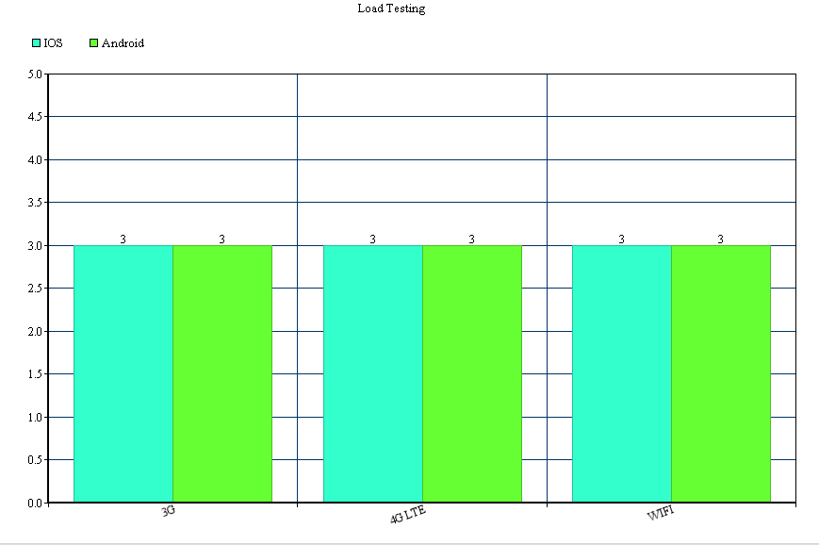
Automation testing
Performance Testing – Neoload.
Native mobile application on proxy mode.

Slide 19
Automation testing
Perfecto Mobile
Cloud based testing tool (TaaS).
Easy to use.
Black box testing.
Wide range to devices/platform to test.
Scripts are easy to write.

Slide 20
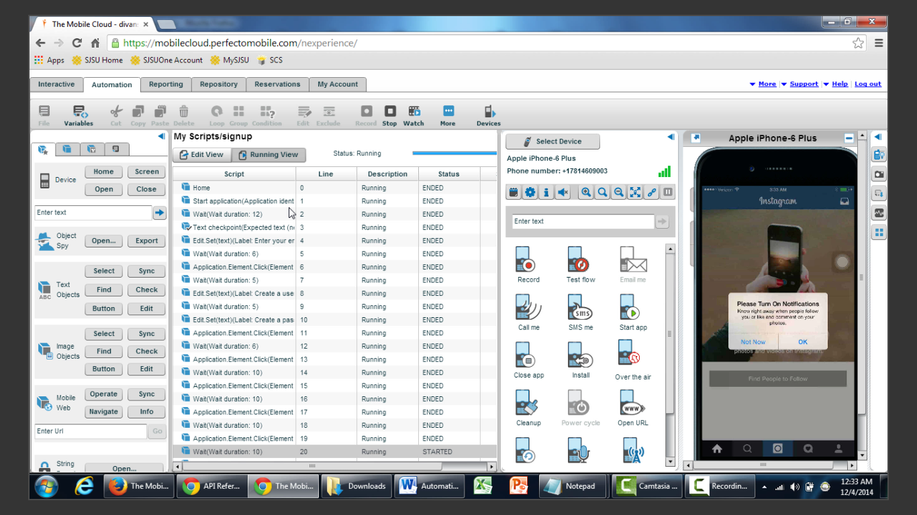
Perfecto mobile

Slide 21
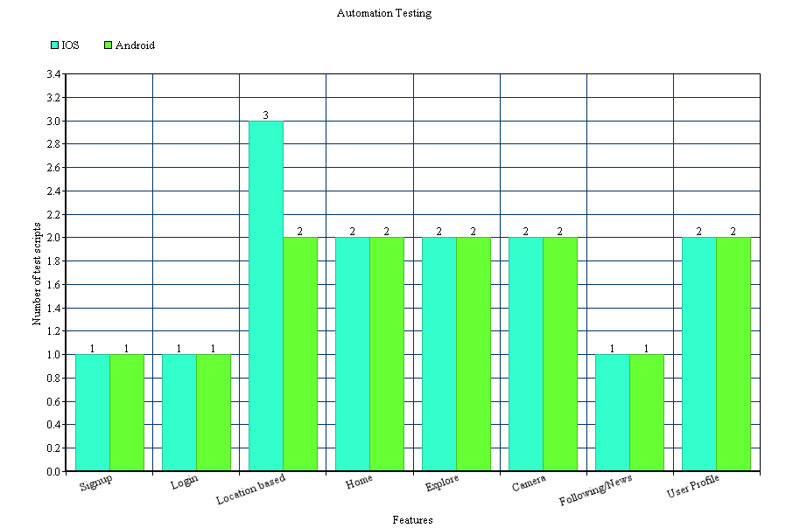
Automation testing
Automation Test scripts statistics
IOS – 14; Android 13

Slide 22
Conclusion -
Learnt how to test a mobile application using various models and methods.
Learnt about the location based testing model.
Testing can never be 100%; even production has some bugs.
Manual testing.
Automation testing.
Testing tools.

